Slide 1

01
Analysis of the Relationship Between TCMB Interest & Inflation Rates and Google Search Trends
TERM PROJECT- DSA210
YAĞMUR GEÇIM

Slide 2



02
Overview
This project aims to analyze the relationship between the monthly interest and inflation rates published by the Central Bank of the Republic of Turkey (TCMB) and the frequency of Google searches for the terms inflation, interest rate, euro, and dollar. By examining search trends over the past five years, this study seeks to understand how economic concerns influence public interest in these topics.
Project Goal
The primary goal of this project is to analyze the interaction between TCMB’s interest and inflation rates and Google search trends for economic terms over the past five years. By using monthly data, this study seeks to uncover potential patterns and relationships that indicate public reaction to economic changes.

Slide 3


03
Hypothesis
This study tests the following hypotheses:
Interest Rate Changes and Search Trends: Increases or decreases in TCMB’s interest rates correlate with fluctuations in search volumes for "faiz" (interest rate) and "dollar/euro."
Inflation and Public Interest: Rising inflation leads to increased searches for "enflasyon" (inflation), as the public seeks more information about its impact on daily life.

Slide 4

04
Data Sources
Google Search Trends-> “Inflation”
Google Search Trends-> “Interest”
Google Search Trends-> “Euro”
Google Search Trends-> “Dollar”
TCMB Interest Rates
TCMB Inflation Rates

Slide 5


Data Analysis
Correlation Analysis:
Spearman’s rank correlation was computed to examine how changes in interest rates and inflation rates correlate with fluctuations in Google search volumes for terms like "faiz" and "enflasyon".
Hypothesis Testing:
Two hypotheses were tested:
Interest Rate Changes and Search Trends: Whether changes in TCMB's interest rate have a noticeable impact on public search behavior related to financial terms.
Inflation and Public Interest: Whether inflation correlates with an increase in searches for "enflasyon" and related terms.
05

Slide 6

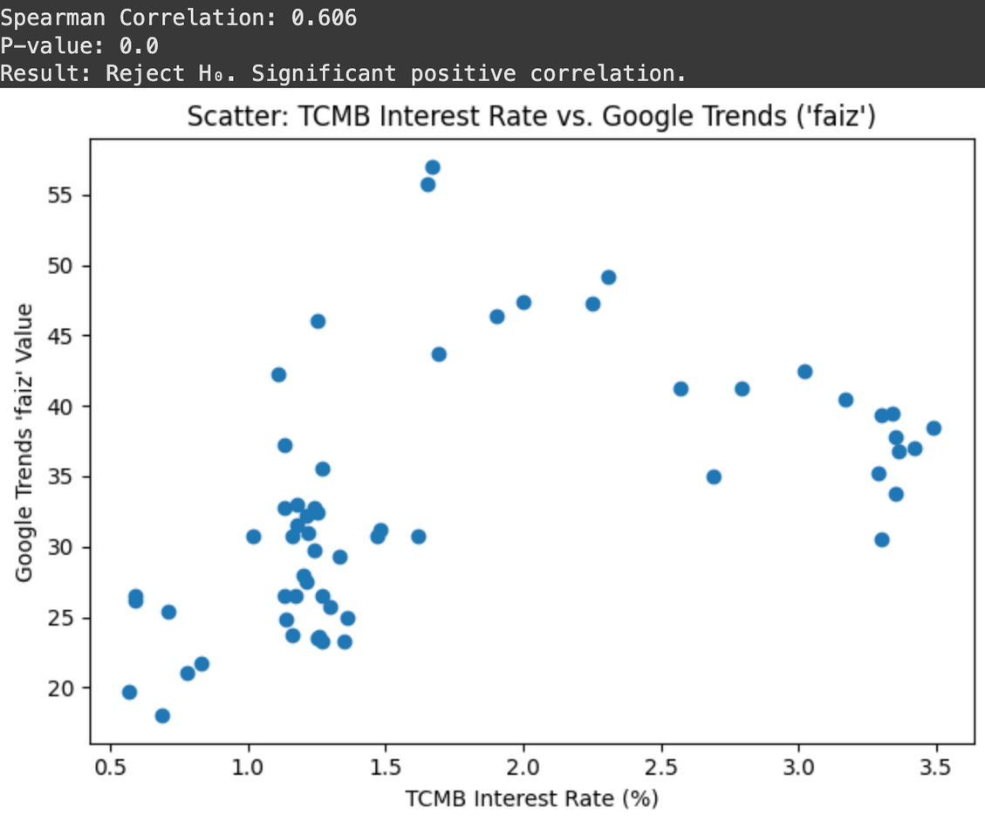

06
TCMB Interest Rates vs Google Trend Data for “Faiz”
A moderate positive correlation was found between TCMB interest rate changes and searches for "faiz" (interest rate).
RESULTS FROM HYPOTHESIS TESTING

Slide 7


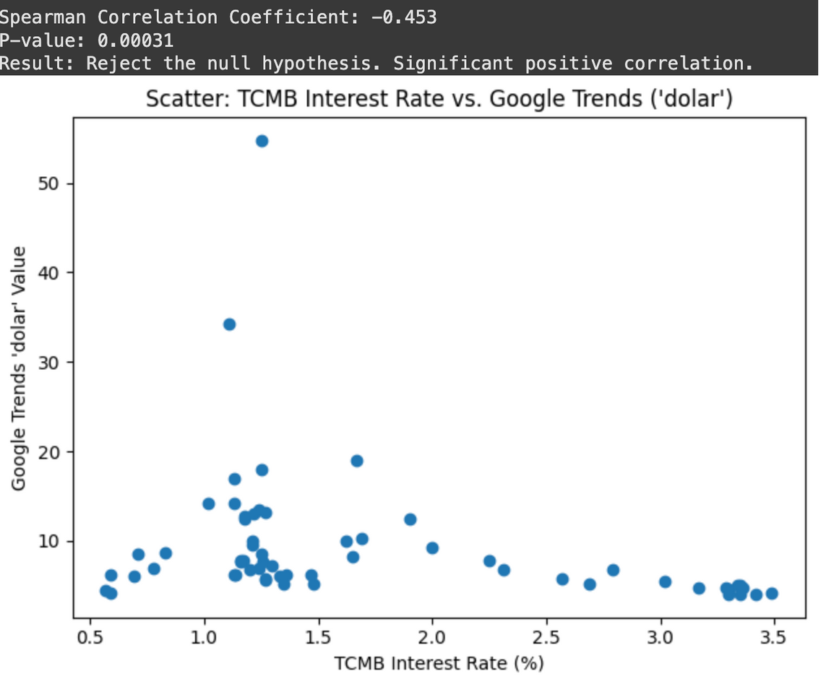
TCMB Interest Rates vs Google Trend Data for “Dolar”
The scatter plot reveals a negative relationship between TCMB's interest rate and the Google search volume for "dolar" (dollar). The Spearman correlation coefficient of -0.453 indicates a moderate negative correlation
RESULTS FROM HYPOTHESIS TESTING

Slide 8
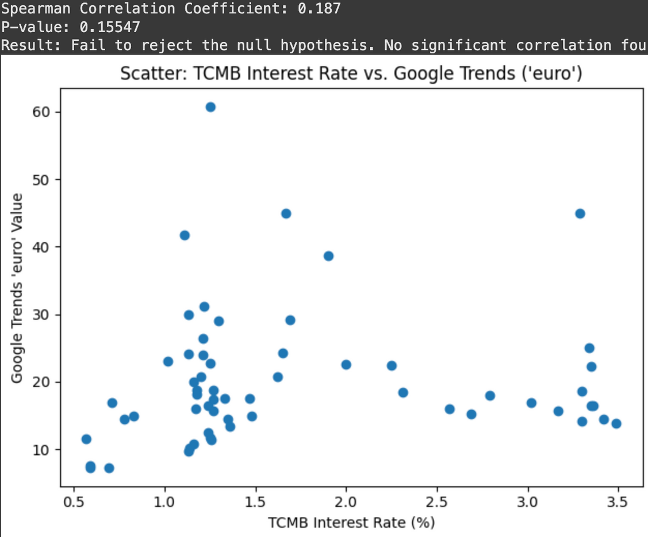

TCMB Interest Rates vs Google Trend Data for “Euro”
08
The scatter plot shows the relationship between TCMB's interest rate and Google search volumes for "euro". The Spearman correlation coefficient of 0.187 indicates a very weak positive correlation.
RESULTS FROM HYPOTHESIS TESTING

Slide 9

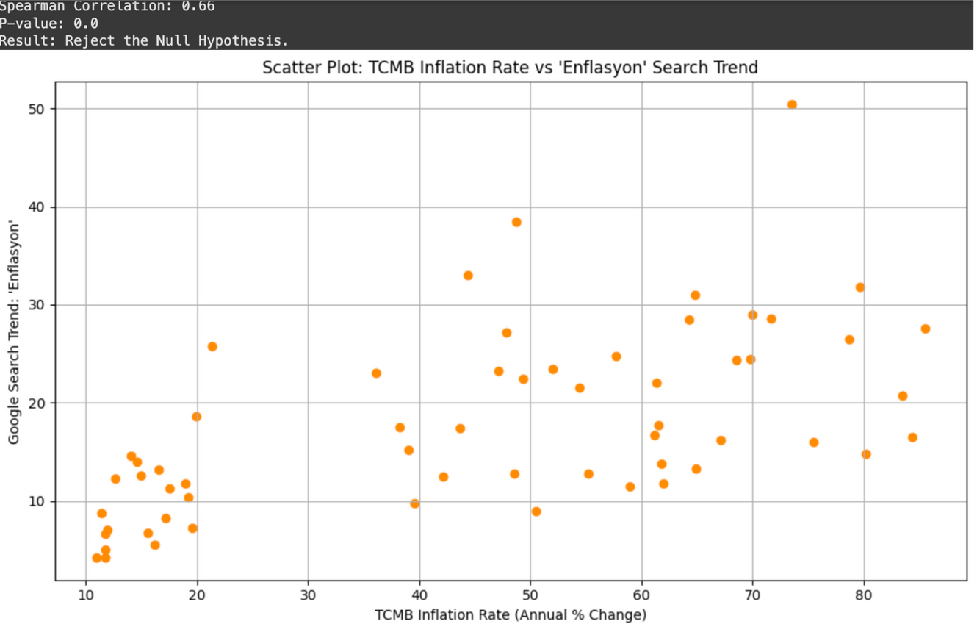

TCMB Inflation Rates vs Google Trend Data for “Enflasyon”
The scatter plot shows the relationship between TCMB inflation rate (annual percentage change) and the Google search trend for "enflasyon" (inflation). The Spearman correlation coefficient of 0.66 suggests a moderate positive correlation
09
RESULTS FROM HYPOTHESIS TESTING

Slide 10


10
MACHINE LEARNING
Machine Learning
Linear Regression
Decision Tree
Random Forest

Slide 11

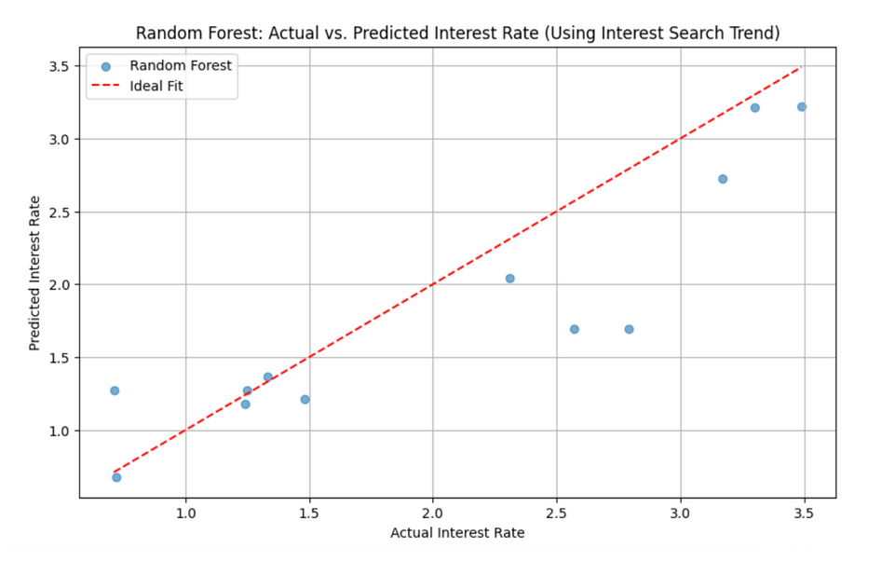
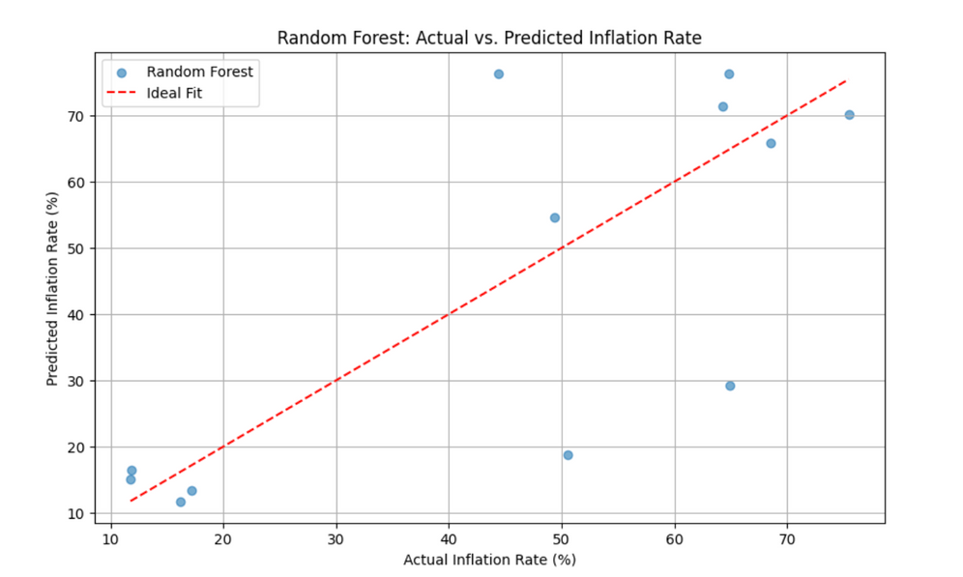
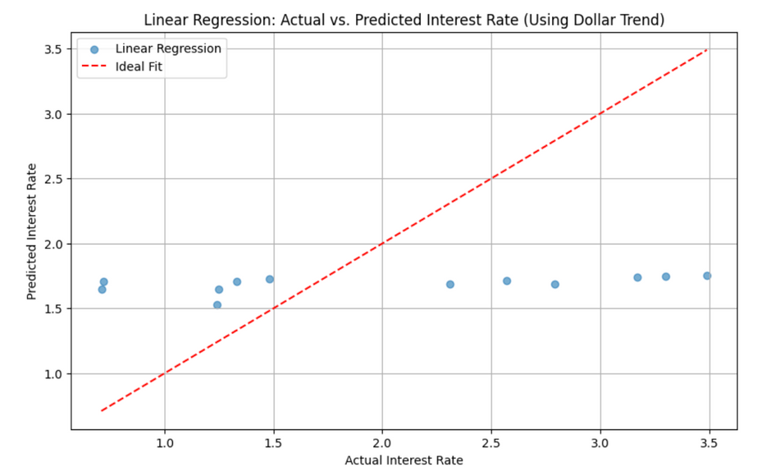
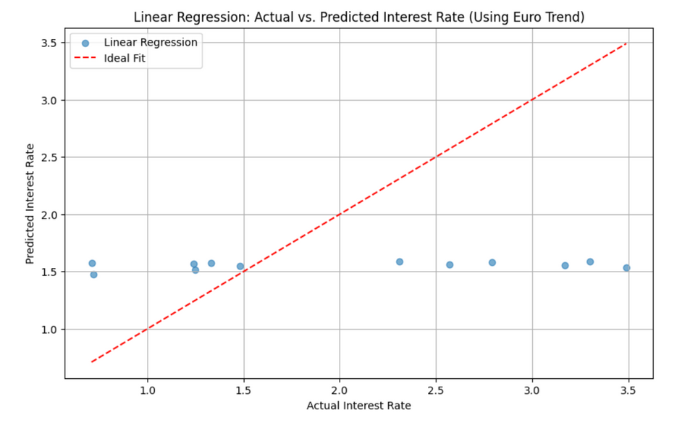
BEST MODELS
R² SCORE OF 0.76
R² SCORE OF 0.44
11
R² SCORE OF -0.05
R² SCORE OF -0.21

Slide 12


12
This project demonstrates that Google search trends—especially for terms like interest and inflation—can serve as meaningful predictors of Turkey’s central bank rates. Among the models tested, Random Forest performed best in estimating both interest and inflation rates, achieving a strong R². On the other hand, search trends for dollar and euro showed weak or no predictive power when used alone. These results suggest that public attention, as reflected in search behavior, is more aligned with macroeconomic indicators like interest and inflation than with currency trends.

